Slide 1
Movie Success Predictor
Compiled by:
Shreya Venugopal PES2201800688
Manav Agarwal PES2201800025
Rishab Kashyap PES2201800065
https://github.com/shreya1010svg/Movie-success-predictor.git

Slide 2
Introduction
People love watching movies and would like a good analysis of whether it would be a success or not.
This would definitely help distributors and theatre owners as well to decide the number of screens they wish to show the movie on, and the money transfer between them.
Hence we have created a movie success predictor which takes in values to predict the success rate of the movie.
We shall be using the IMDb extensive dataset from Kaggle for the same.
Consists of various attributes and features from a total of 4 datasets from which we select the features we wish to use from it

Slide 3
Why success prediction?
As mentioned before success prediction has a lot of advantages not just to the common population but also to the distributors too.
To begin with people get varied ratings from IMDb or Rotten tomatoes or any other website, but these are usually biased based on the individual who has given the rating.
The success predictor model not only considers these scores but also the various factors that have affected the production of the movie.
This especially helps theatres in deciding how many screens to show the movie on depending on it’s success rate, and also allows them to calculate profits, etc.

Slide 4
Approach to the Problem
Based on the problem statement in hand we have applied various regression and classification models to predict the possibilities of the movie being a success or a failure.
Selective attributes such as the genre, budget of the movie, and a few other features have been selected to do so.
Each model type returns a certain set of values depending on which we classify them into a successful movie or an unsuccessful one.
In our case we have 3 divisions - unsuccessful, mediocre and successful movies.

Slide 5
Evaluation of output
As seen in the previous slide, the model we use takes in the input values to produce an output.
In this case, based on the model we use, the input values are the attributes that influence the movie’s success rating, and the output value is the rating itself, that is, the metascore values given to each movie by a random set of users.
The metascore values are divided into 3 ranges as seen before for classifying the movie type.
Once we feed the trained model the input data, the output data is compared with the ranges using a confusion matrix
The final outputs obtained from the above method determine not only the success rate of a movie but also the accuracy of the model’s predictions.
An additional time-series analysis is performed to observe the various trends and seasonality pertaining to the dataset we have chosen.

Slide 6
Observations and Results
From the entire analysis of the models we observe that some of the models yield better results than the rest, even if they have the same residue values in the case of regression models.
Our dataset yields an average of 70% in terms of accuracy in classification for our dataset.
The time-series analysis shows us an interesting variation in the pattern of movie popularity over the years. We see that it follows a partly uniform seasonality through the years.
The outputs from all the models we have implemented is shown in the slide that follows.

Slide 7
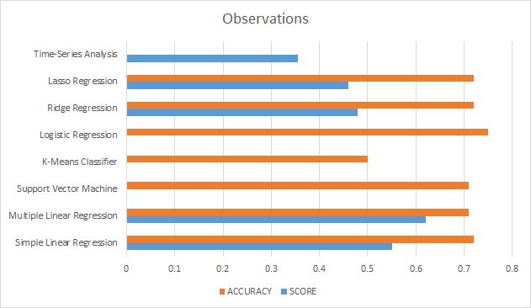
BAR CHART DISPLAYING THE OUTPUTS OF ALL THE MODELS IMPLEMENTED
(Time series score only for display, not comparison)

Slide 8
Contributions
Shreya Venugopal
Literature review - 1, EDA
Report Documentation
Models: K-Means classifier, Logistic regression, SVM
Confusion Matrix tests, Multi-Label Binarizer values
Manav Agarwal
Literature review - 2
Report Documentation
Models: Ridge regression, Lasso Regression, SVM
Cleaning and splitting of datasets, model comparison chart
Rishab Kashyap
Literature review - 3, EDA
Report Documentation
Models: Simple Linear Regression, Multiple Linear Regression, Time Series Analysis, K-Means classifier

Slide 9
THANK YOU

